Slide 1
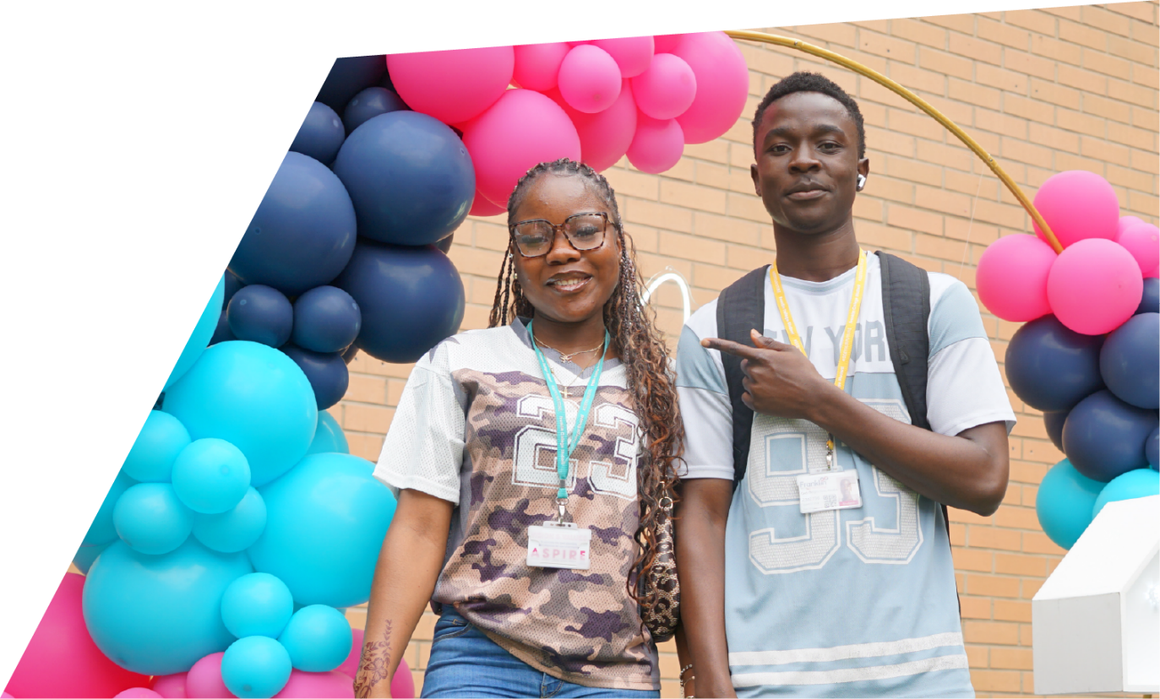
Parents as Partners Study Skills and Revision Support

Slide 2
Session aims
Simple overview of how we learn
Review the most popular revision/study strategies
Generic support to support well-being
Specific and effective evidence-based revision/study strategies.
Notes:
Give out packs

Slide 3
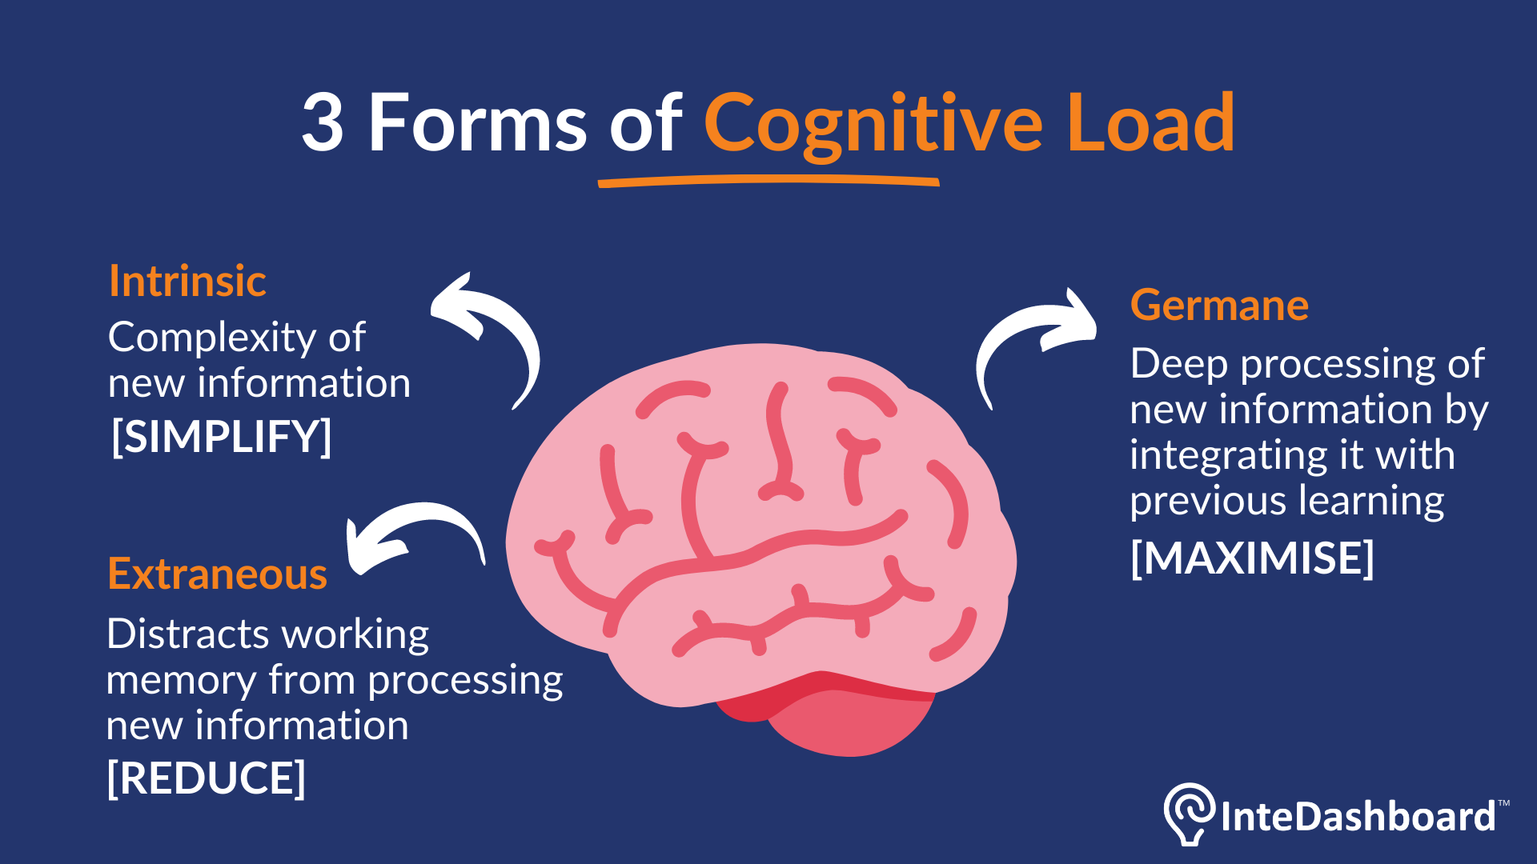
Cognitive Load Theory

Slide 4
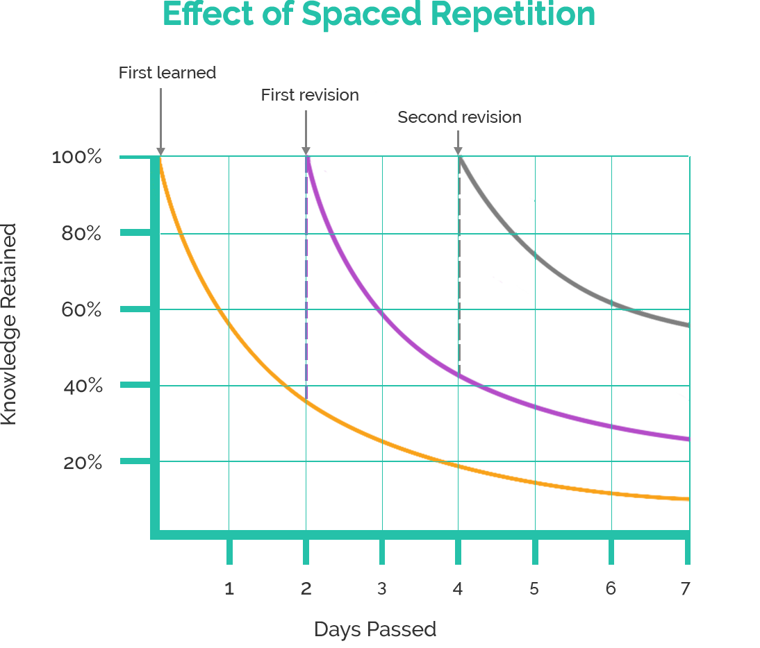
Spaced Repetition and Memory

Slide 5
Timescales and Expectations
​
From today to first exam – 12 weeks​
Taught sessions left – 32
​
Weekly revision… How much are you planning/doing?​
​
1 hour = 13hrs (is that realistically enough?)​
4½ hours = 58 ½ hrs (recommended) ​
Notes:
Brief run through these headings only as info is for the next slide and staff activity (limited time, max 10m)
Case studies (ask staff individually to stand up and quick few mins on what they have done/implemented)
Sherrie: Psy – developed her own ‘clock’ revision method.
Pete: Sport – Used a variety of methods to support recall and better written responses.

Slide 6
General Support
1. Create the Right Environment
Provide a quiet, organised space with minimal distractions.
Agree a realistic revision timetable together.
2. Encourage Healthy Habits
Prioritise good sleep routines—rest supports memory.
Ensure regular breaks, hydration, and balanced nutrition.
3. Be Positive and Supportive
Focus on effort, not perfection.
Celebrate small wins to boost motivation and confidence.
​
Notes:
Brief run through these headings only as info is for the next slide and staff activity (limited time, max 10m)
Case studies (ask staff individually to stand up and quick few mins on what they have done/implemented)
Sherrie: Psy – developed her own ‘clock’ revision method.
Pete: Sport – Used a variety of methods to support recall and better written responses.

Slide 7
General Support
4. Stay Involved (Without Taking Over)
Ask questions about what they are revising—not to test, but to help them reflect.
Show interest in their subjects and listen when they feel stressed.
5. Encourage Balance
Build in downtime, hobbies, and social time.
Remind them that staying well is part of revision success.
6. Keep Communication Open
Let them know it’s normal to feel stressed.
Make home a space where they can talk openly about worries.
​
Notes:
Brief run through these headings only as info is for the next slide and staff activity (limited time, max 10m)
Case studies (ask staff individually to stand up and quick few mins on what they have done/implemented)
Sherrie: Psy – developed her own ‘clock’ revision method.
Pete: Sport – Used a variety of methods to support recall and better written responses.

Slide 8
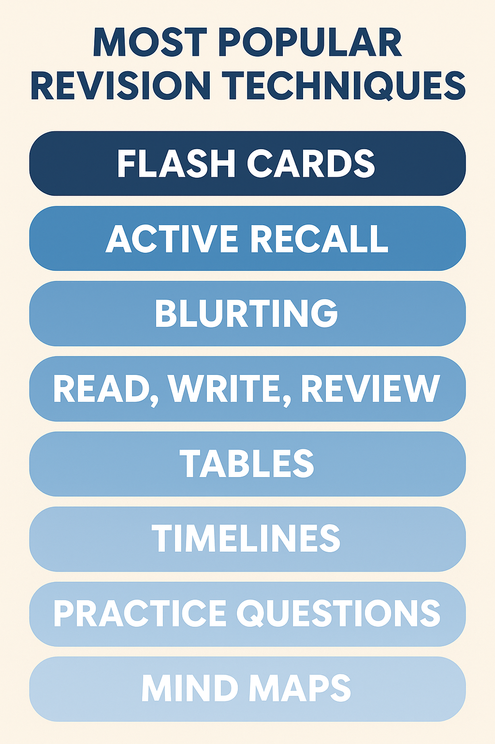
Over 1000 responses (Yr 1/2 combined)
Notes:
Brief run through these headings only as info is for the next slide and staff activity (limited time, max 10m)
Case studies (ask staff individually to stand up and quick few mins on what they have done/implemented)
Sherrie: Psy – developed her own ‘clock’ revision method.
Pete: Sport – Used a variety of methods to support recall and better written responses.

Slide 9

RAG rating for revision
Feel unsure about it
Would worry if I had to write about it or if it was in an exam
Can’t remember anything when I look at it again
Uncertain of how to apply it or use it when I work independently
I’m ok with some bits but not others
Slightly worried if it comes up in anything that I don’t know it fully
Can remember when I look at it but forget when it’s not in front of me
Can’t seem to find a good way to be able to revise for this so it sticks
Can reel info off without any preparation
Strategies for remembering things without having to look at anything
Feel confident on all key topics and sub-topics within reason
Would feel ok if this came up in an assessment or exam
Notes:
RAG rating – Importance in relation to spaced repetition
Go through them and ask students to personally identify where they think that they are in terms of revision for subjects/topics (no student feedback required).
Reinforce that despite being uncomfortable, they need to be revising in the amber and red areas – that should be their focus.
Green is a good place to start but they should not be living in the green if they want to improve.

Slide 10
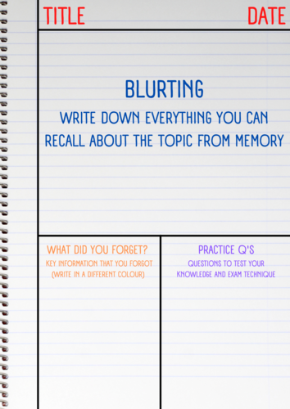
Blurting

Slide 11
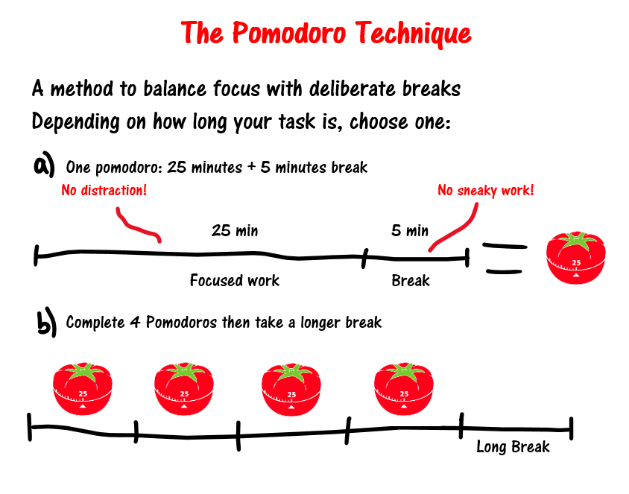
Pomodoro Technique

Slide 12
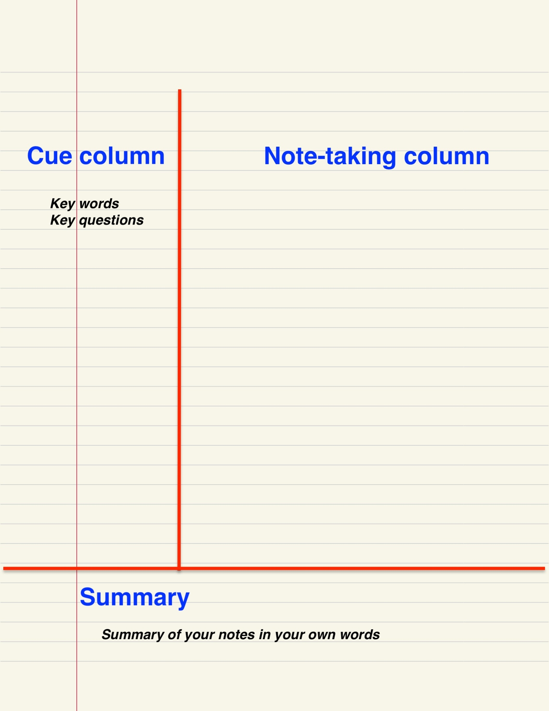
Cornell Note-Taking

Slide 13
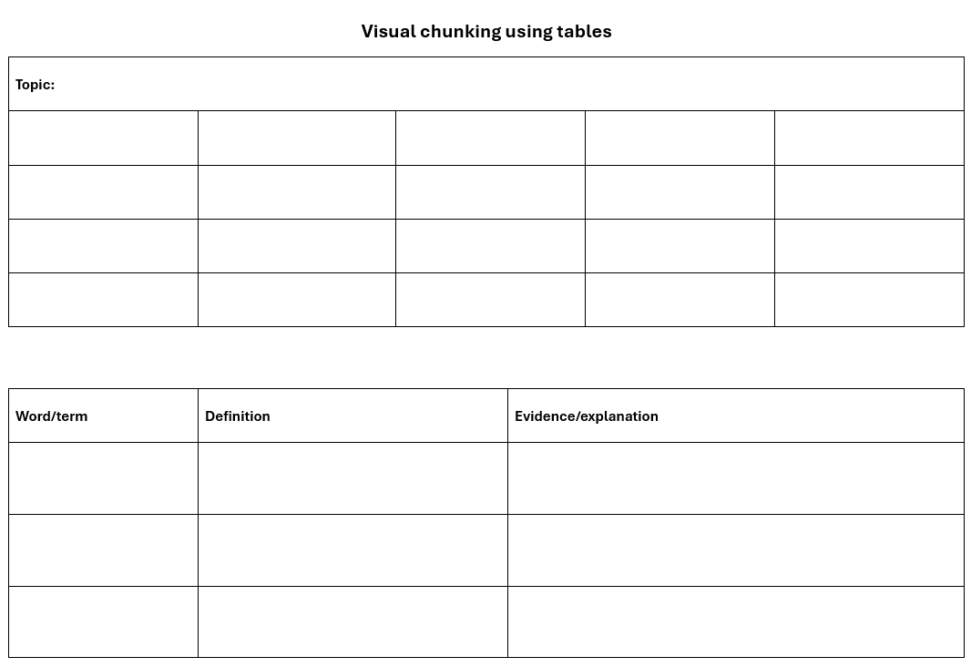
Chunking Information

Slide 14
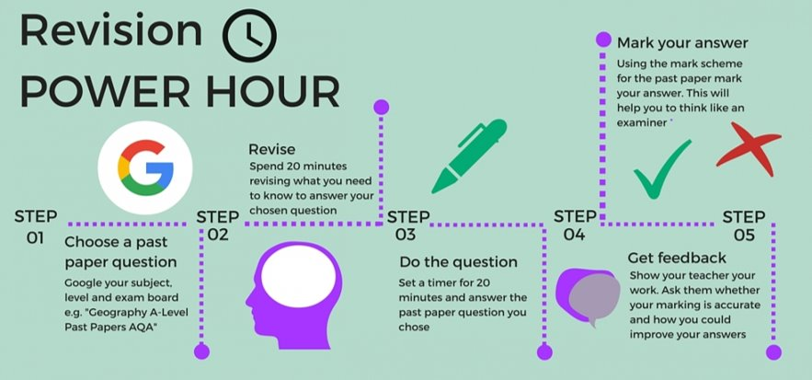
Past papers and mark schemes

Slide 15
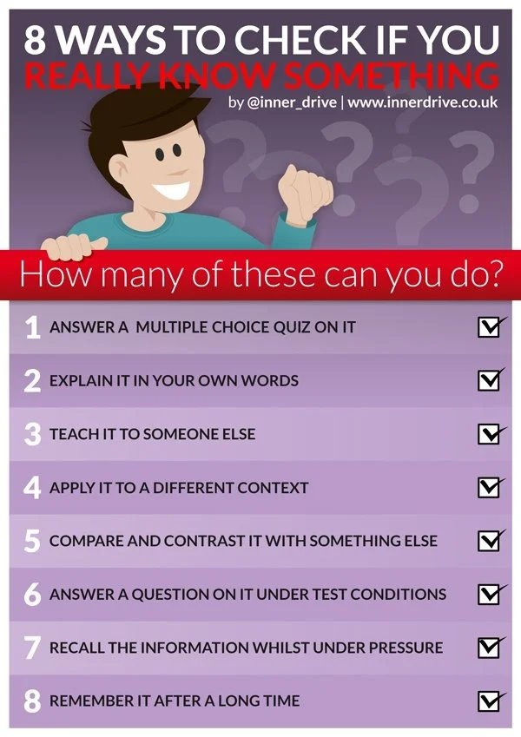
Summary of Effective Strategies

Slide 16
Digital Platforms
Tutor 2U Examiner AI by tutor2u
Quizlet https://quizlet.com/
Gizmo https://gizmo.ai/
Notebook LM https://notebooklm.google/

Slide 17
Help and Support
Book an Appointment with a Study Skills Coach
Theresa.Marriott@franklin.ac.uk
Lauren.Needham@franklin.ac.uk
AIMS-Academic Improvement Mentors
Subject Student Mentors
Resources-gary.thomas@franklin.ac.uk

Slide 18
Resources
How to revise using the blurting method: https://www.bcu.ac.uk/exams-and-revision/best-ways-to-revise/the-blurting-method
How to use past exam papers to revise effectively: https://www.theuniguide.co.uk/advice/revision-help/how-to-use-past-exam-papers-to-revise-effectively
Read, write, review using the SQ3R Method: https://subjectguides.york.ac.uk/study-revision/sq3r-method
Revision mind maps – Your key to exam success: https://www.savemyexams.com/learning-hub/revision-tips/revision-mind-maps-your-key-to-exam-success/
Summarising your work (tables): https://help.open.ac.uk/revision-techniques/summarising-your-work
Creating visual timelines for revision: https://mrthorntonteach.com/2016/04/06/visual-timelines/
5 simple and effective task management strategies: https://www.meistertask.com/blog/3-simple-methods-more-effective-task-management
7 practical ways to apply active recall when studying: https://www.goodnotes.com/blog/active-recall-studying
Notes:
Helpful links to more info and resources.

